Slide 1
NE 763: Advanced Reactor Materials
Fall 2026
Dr. Benjamin Beeler

Slide 2
Last Time
Fluorides for thermal (and fast), chlorides for fast
Li7 enrichment and Cl37 enrichment to avoid neutron absorption (and tritium production)
Solute species serve to modify salt properties: lower the melting point, lower viscosity, etc., and can dually serve as an oxygen getter; target low viscosity, high Cp/Kth, low vapor pressure
Eutectic compositions are typically of interest
Need an O getter to prevent UO2 formation – need something to strip O from UO2
Fluorine potential increases dramatically with burnup – inability of FPs to getting released F
Need to target UF4/UF3 < 100 as proxy for redox potential and limit cracking
Too low UF4/UF3 leads to UC formation
FPs form FP-salts, noble gases, or noble metals plating out

Slide 3
Cover Gas
Need a system to clean up the salt and monitor/modify chemistry
The cover gas (off-gas) handling system is a key element of any MSR
Fission gases such as xenon and krypton will readily escape the salt
Acidic gases may accumulate as a result of radiolysis
Tritium is formed by neutron interactions with light elements in the salt
The cover gas system will contain the radionuclides emerging from the free surface above the fuel salt as well as any sweep or sparging gases used

Slide 4
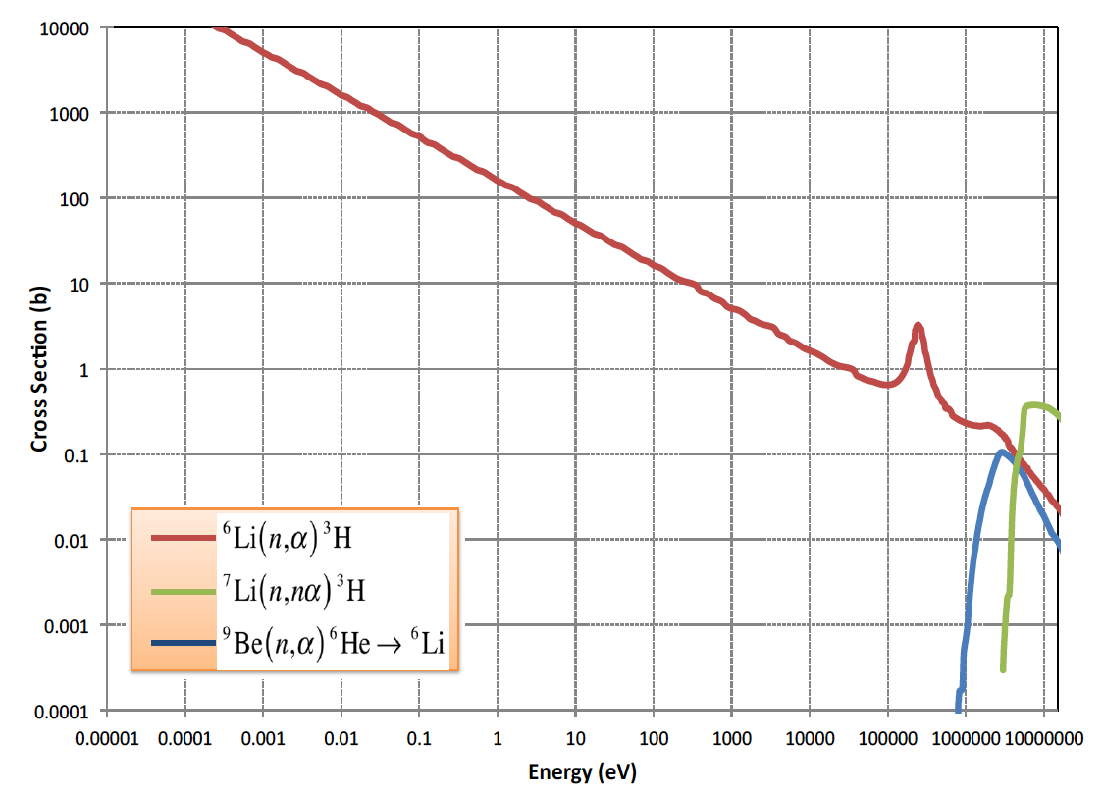
Tritium
Tritium production and control is an issue for Li-bearing salts
Tritium is produced by neutron reactions with lithium, beryllium, and fluorine as well as being a ternary fission product
Tritium can exist as ions or as TF, depending on redox conditions
Above 300C tritium will diffuse through structural materials

Slide 5
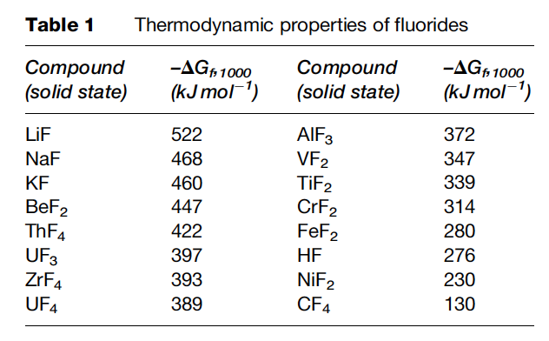
Radiolytic Stability
Radiolysis is the dissociation of molecules by ionizing radiation
Molten salts are highly radiolytically stable
Salts are combinations of strongly electronegative elements with strongly electropositive metals with very high bond energies
Formation energy of alkali/alkaline salts is more negative than metal fluorides
Radiolysis of key molten salt species is generally not of concern… or is at least ignored

Slide 6
Molten salt corrosion

Slide 7
Three principal corrosion processes
Reactions due to oxides on the metal
Reactions with dissolved impurities
Reactions with necessary constituents of the melt

Slide 8
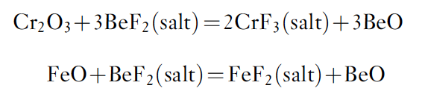
Protective coatings?
It is not useful to apply a protective coating of, for example, an oxide layer on the structural material for the two following reasons:
  although some oxides are relatively insoluble in the fluoride melt, most are readily dissolved
  all oxides rapidly recrystallize
Thus, oxide films on the surface of the alloy can be attacked by the fluoride melt and effectively dissolved
The formed oxides (BeO below) typically don’t matter as long as they do not contain fissile elements
The formed fluorides are more important as they will act as oxidants of Cr in the alloy

Slide 9
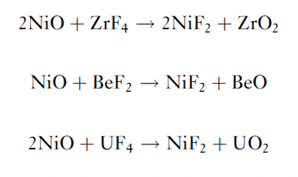
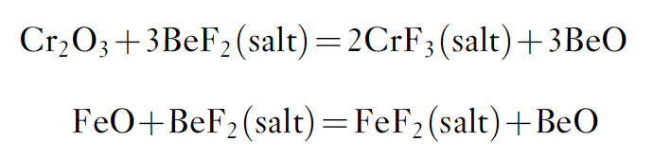
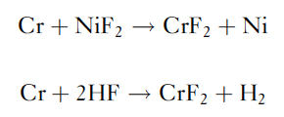
Oxides and Impurities
Structural materials will have been exposed to air, and thus have oxide films
Oxide films on the metal are dissolved, leading to cladding constituent fluorides
Other corrosion reactions are possible with solvent components
Such reactions can lead to rapid initial corrosion
These impurity reactions can be minimized by maintaining low impurity concentrations in the salt and on the alloy surfaces

Slide 10
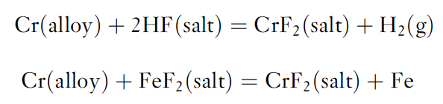
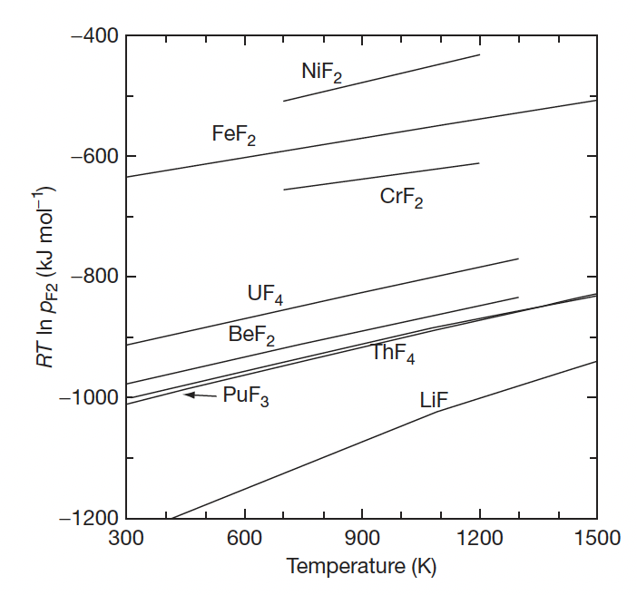
Dissolved Impurities
In addition to impurities generated by reactions with oxides, impurities may result from incomplete removal of HF or of easily reducible fluorides during the salt purification
Understanding what chemical reactions can take place, which are favorable, and under what conditions, is key to predicting molten salt corrosion

Slide 11
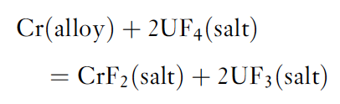
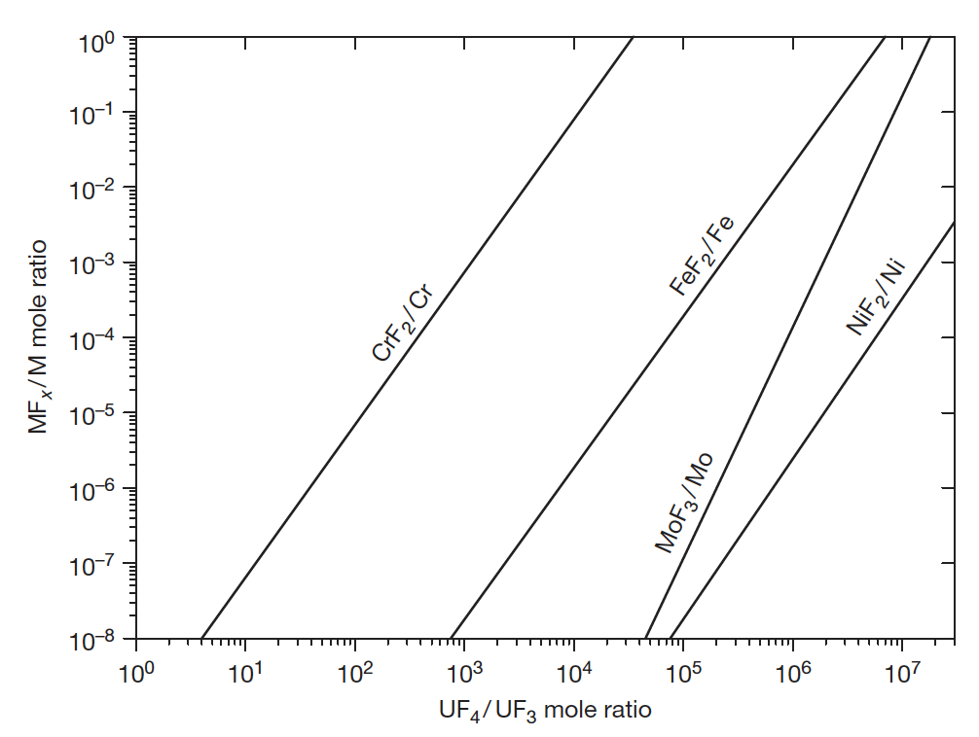
Constituents of the Melt
The oxidation reaction of alloy components with UF4 has been suggested to play an important role in corrosion
The equation will define/buffer the electrochemical potential of the salt via the UF4/UF3 ratio
Excess fluorine liberated via fission increases fluorine potential, forming more UF4 and increasing corrosion rates
Based on reasonable estimations of the activity coefficients for the above reaction, the equilibrium concentration of CrF2 is of the order of 130–300 ppm for a fuel with 1% UF3 contained in Hastelloy-N

Slide 12
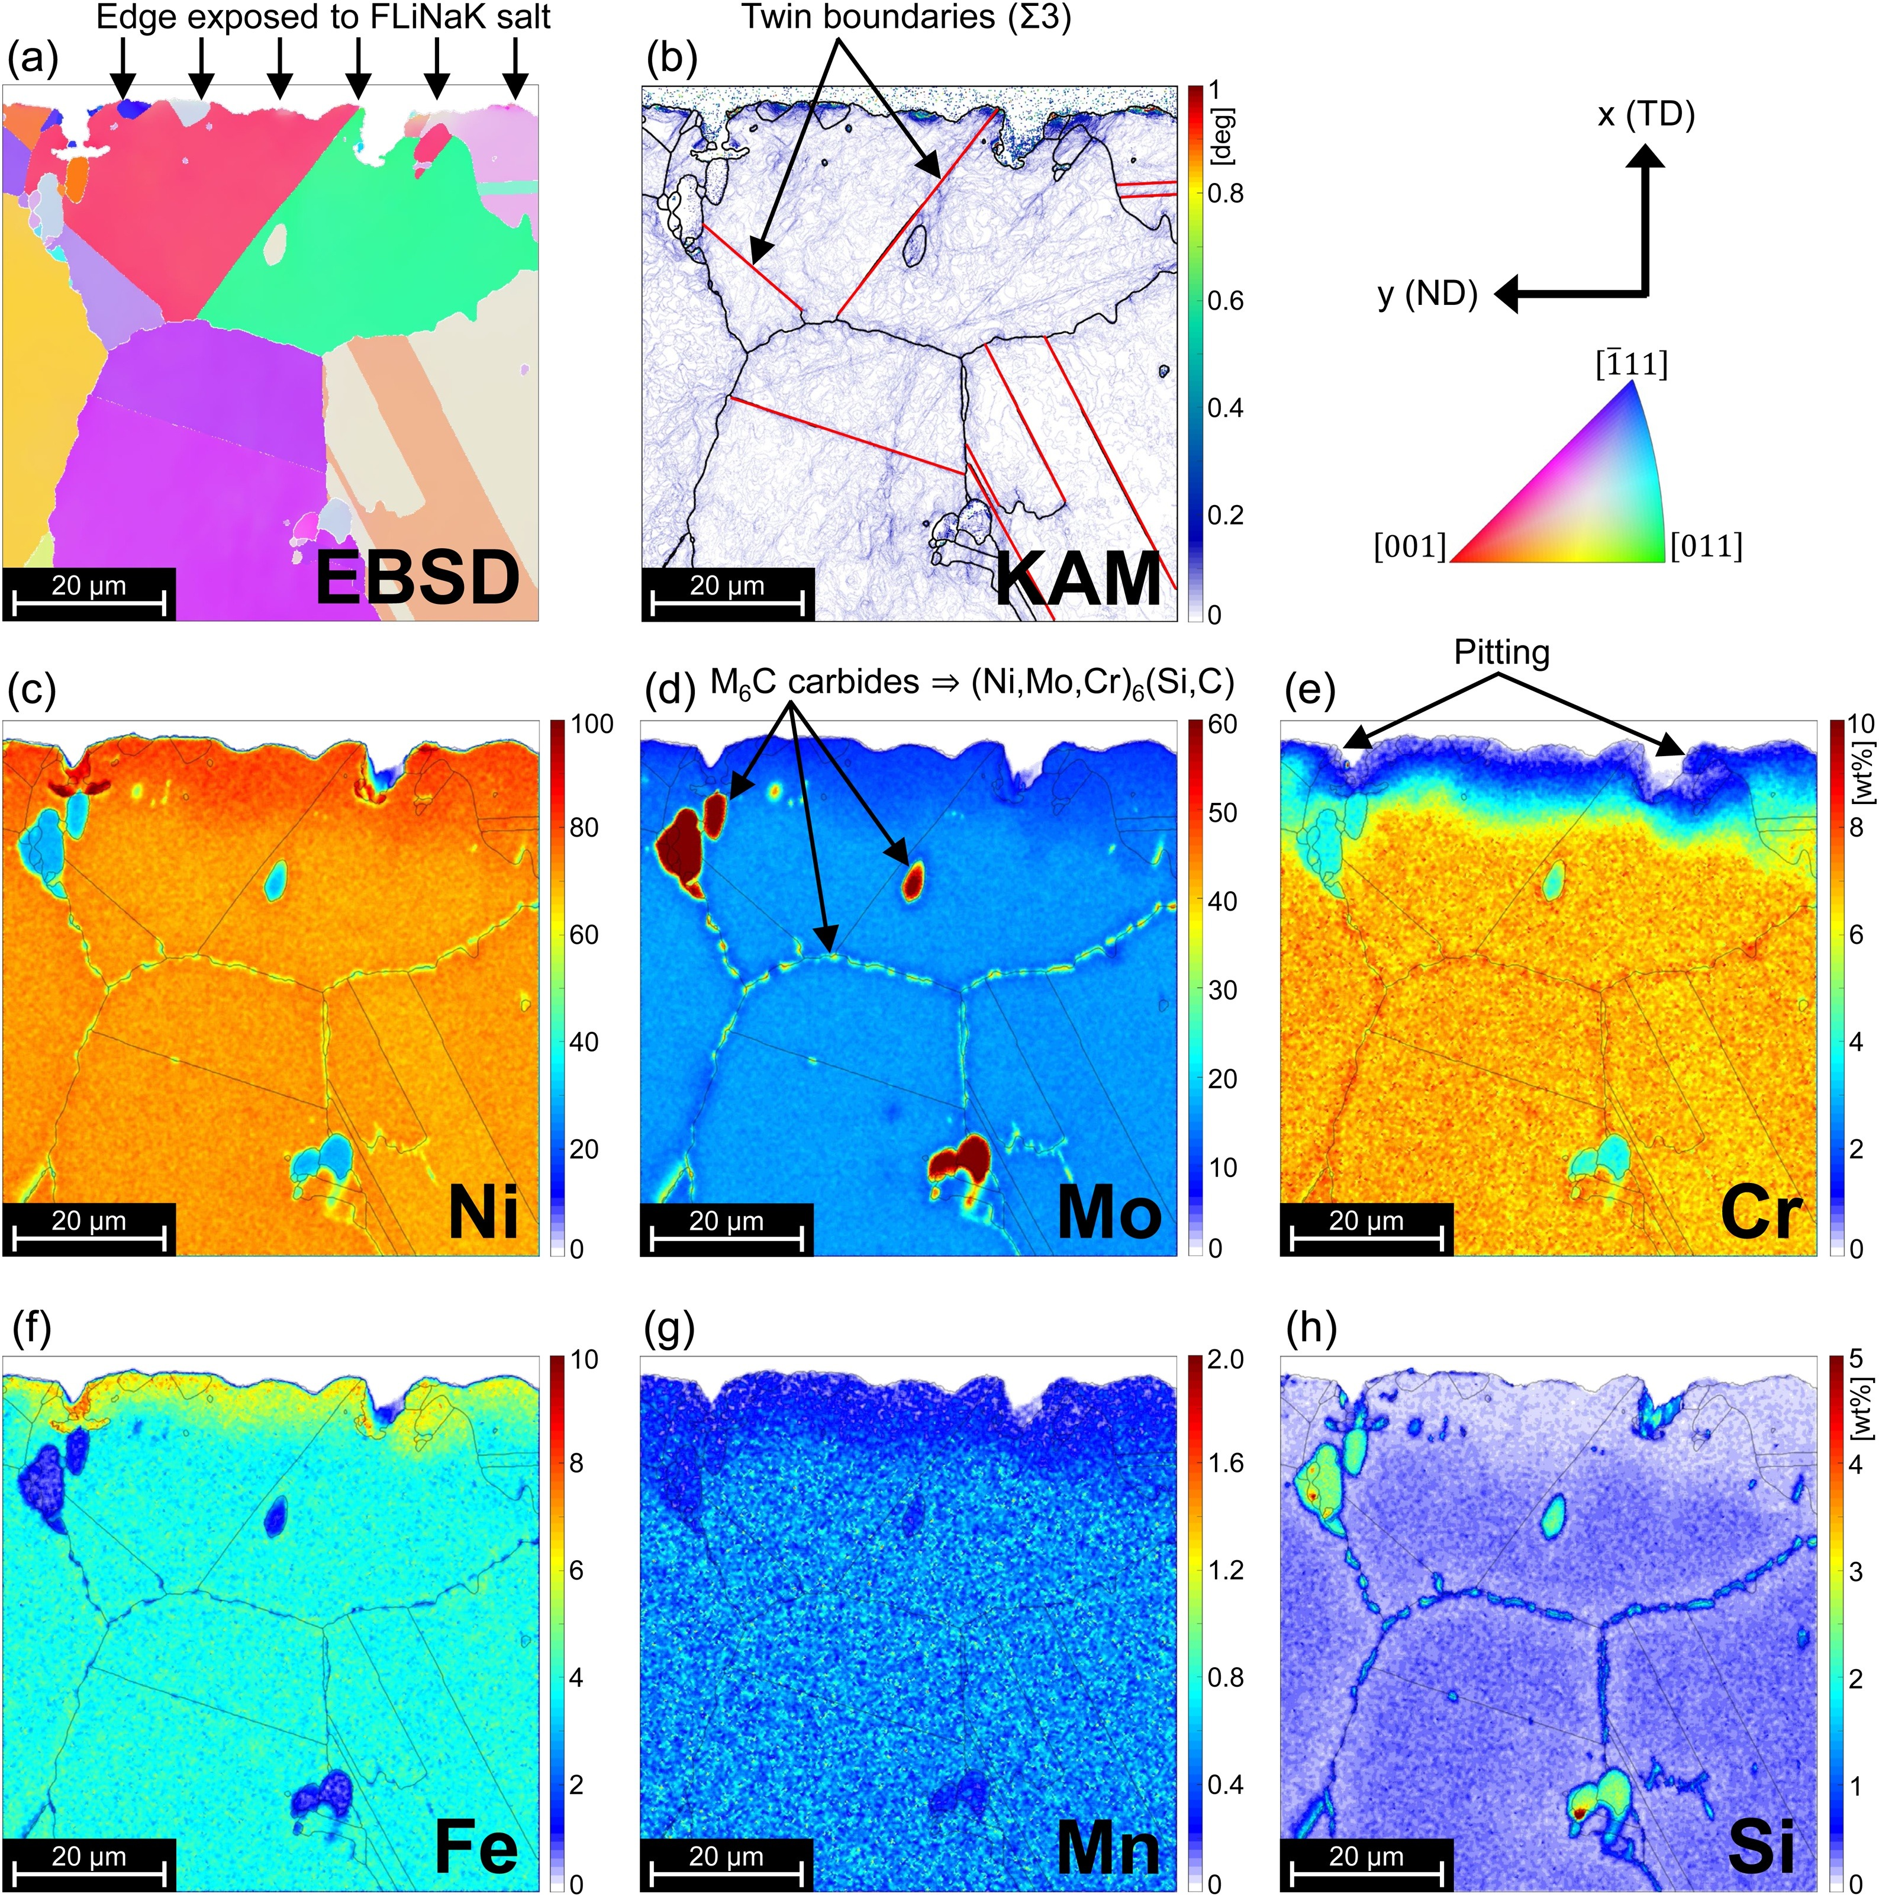
Cr ‘Oxidation’
Redox processes responsible for attack by fluoride mixtures on the alloys result in selective oxidation of the contained Cr
This removal of Cr from the alloy occurs primarily in regions of highest temperature
The rate of corrosion has been measured and was found to be controlled by the rate at which chromium diffuses to the surfaces undergoing attack
https://doi.org/10.1016/j.corsci.2019.108306

Slide 13
Pause and Recap
Excess fluorine generated through fission increases the redox potential
Some fission products will form fluorides, some will exist as gases, some as metals
Cover gas serves to remove gaseous species and He bubbling with particle traps remove precipitates
Corrosion occurs through reactions with oxides on the metal, with dissolved impurities, and with salt constituents
Oxides dissolve in salt, leading to generation of metal fluorides
Cr->CrF2 is most likely structural material reaction and dictates the maximum redox potential
UF4/UF3 ratio is the proxy for redox potential, and should be kept at ~100

Slide 14
Materials for MSR systems
The materials required fall into three main categories: (1) metallic components for primary and secondary circuits, (2) graphite (or other structural steels) in the core, and (3) materials for molten-salt fuel reprocessing systems
The metallic material used in constructing the primary circuit of an MSR will operate at temperatures up to 700–750C
Operating lifetime of 30-50 yrs, with fluences of up to 8x10²¹ n/cm²
The metal must have moderate oxidation resistance, must resist corrosion by the salt, and must not be subject to severe embrittlement by neutrons
The material must be shapeable, with wall thicknesses from >1cm to less than 1mm, and weldable

Slide 15
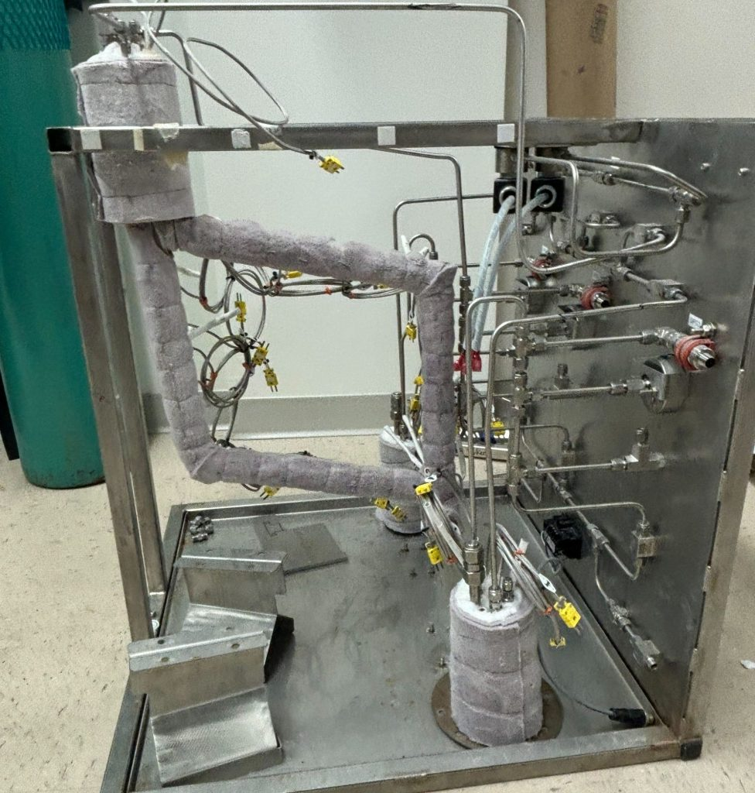
Metallic Materials for MSR systems
Fairly extensive literature exists on corrosion of metal alloys by molten fluorides in convection or forced flow loops
Limited experimental efforts on irradiation-combined corrosion effects
Nickel-based and austenitic stainless steels were primarily investigated
Salt corrosion loop at UW-Madison

Slide 16
Metallic Materials for MSR systems
General knowledge:
Corrosion is associated with outward diffusion of Cr through the alloy
Corrosion rate is marked by initial rapid attack associated with dissolution of Cr and is largely driven by impurities in the salt
This is followed by a linear corrosion rate which is controlled by mass transfer
Minor impurities in the salt can enhance corrosion by several orders of magnitude
Dissolution can be mitigated by a chemical control of the redox conditions in the salts

Slide 17
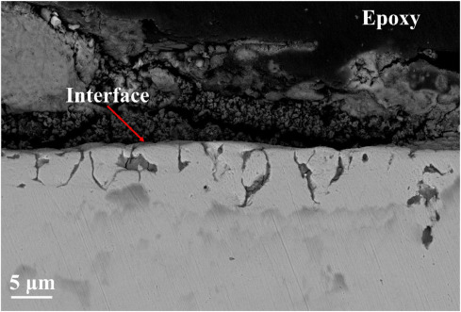
Metallic Materials for MSR systems
Stainless steels, Inconel 600, Hastelloy-B, and Hastelloy-W were explored, but either excessively corroded or had poor aging properties
Hastelloy N was developed with a composition of Ni–16%Mo–7%Cr–4%Fe–0.05%C
Limited Cr is included to impart moderate oxidation resistance in air, but not high enough to lead to high corrosion rates in salt
Hastelloy N has excellent corrosion resistance to molten fluoride salts at temperatures considerably above those expected in MSR service
Intergranular corrosion of stainless steel 316L in molten LiCl-NaCl-KCl salt at 700 °C

Slide 18
Metallic Materials for MSR systems
Problems with Hastelloy-N
Is subject to irradiation hardening due to accumulation of He at grain boundaries
This is potentially mitigated through alloys with fine carbide precipitates to trap He
Tiny cracks formed on the inside surface of Hastelloy-N piping for the MSRE
Intergranular cracks were due to Te, which can likely be controlled with appropriate redox conditions
Additions of Ti can aide in fine carbide precipitates, and additions of Nb can limit Te cracking
Limited alloys with both additions have been studied, but it is supposed that additions of 1% Ti and 1% Nb might sufficiently solve both problems

Slide 19
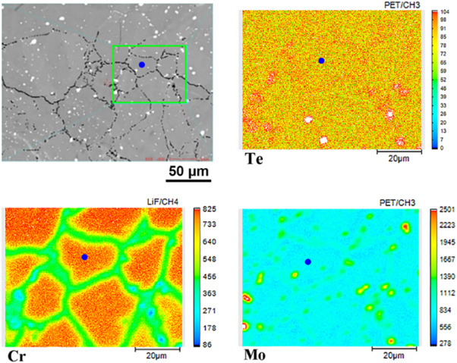
Tellerium
When Te is present in the metallic form in the fuel, it corrodes Ni-based alloys and embrittles its surface grain boundaries
Embrittlement is a vital issue to consider because it can result in cracking of the structural materials
This intergranular embrittlement produced in Hastelloy-N can be significantly reduced by adding 1–2 wt% of niobium into the Hastelloy-N
Another way to suppress the corrosion rate is by increasing the reducing conditions of the fuel, which is done by the decreasing the UF4/UF3 ratio
This allows Te to be present as Te⁻² rather than in an ‘oxidized’ metallic form, and this is less aggressive against the nickel-based alloys
https://doi.org/10.1016/j.corsci.2021.109944

Slide 20
Materials for MSR systems
Focus on graphite core
Graphite is the principal material other than salt in the core of the reference breeder reactor design with a thermal spectrum, or used as a reflector in fast designs
The graphite structures will operate in a fuel salt environment over a range of temperatures from 500 - 800C
There are two main requirements in the graphite in MSRs: that both molten salt and xenon be excluded from open pore volume
Significant penetration of the graphite by the fuel salt would generate a local hot spot, leading to enhanced radiation damage to the graphite and perhaps local boiling of the salt

Slide 21
Graphite for MSR systems
Extensive experimental work has demonstrated the compatibility of graphite with molten salts
Graphite undergoes the same shrinkage/turnaround processes during irradiation
For molten salts, post-turnaround graphite is of concern, due to the increased porosity allowing for salt ingress
This puts a cap on fast neutron fluence in graphite for salt systems at about 3E22 n/cm², which translates into about 3-4 years as a moderator in the MSBR
Graphite needs to be surface-sealed to prevent Xe penetration
¹³⁵Xe can diffuse into the graphite and function as a neutron poison
Pyrocarbon sealing was explored, but led to more rapid turnaround

Slide 22

Graphite Compatibility
Graphite does not react with molten fluoride mixtures of the type to be used in the MSR concepts
After carbon, borides and nitrides appear to be the most compatible nonmetallic materials
Thermodynamic data suggest that the most likely reaction is:
but this should come to equilibrium at very low CF4 pressures
CF4 concentrations over graphite–salt systems maintained for long periods at elevated temperatures have been shown to be below the limit of detection

Slide 23
These materials have been shown to survive!
MSRE graphite and Hastelloy N exposed to coolant salt was clean after 2+ years of operation

Slide 24
Materials for MSR systems
Reprocessing materials
The key operations in fuel reprocessing are (1) removal of uranium from the fuel stream for immediate return to the reactor, and (2) removal fission products from the fuel solvent
One severe corrosive environment in this process includes salt at 550C with F2 and UF6, and so that an average valence of 4.5 exists
Other severe corrosive environment is at 650C with salt containing molten alloys of Bi, Li, Th, etc. with HF-F2 gases
The environment must be an inert gas or a vacuum to prevent deterioration of structural material to ensure long-term service
Typically, Ni or Ni-based alloys have been used for containment

Slide 25
Materials for other Salt Reactor Concepts
AHTR: TRISO particles in graphite compact prismatic core with molten salt coolant
LSFR: solid fueled fast reactor with molten salt coolant
SSR: liquid fueled, non-flowing
Secondary Coolant Loop: may use nitrate, chloride, or fluoroborate salts, with different corrosion
Materials for these systems either experience higher temperatures or higher flux/fluence requirements, and thus Hastelloy-N type materials may not be applicable
Potential options are 9Cr-1MoV coated in Ni, ODS Ni alloys, Ni-based superalloys, ODS Fe alloys, and Mo alloys
Stainless steels can be options for secondary loop

Slide 26
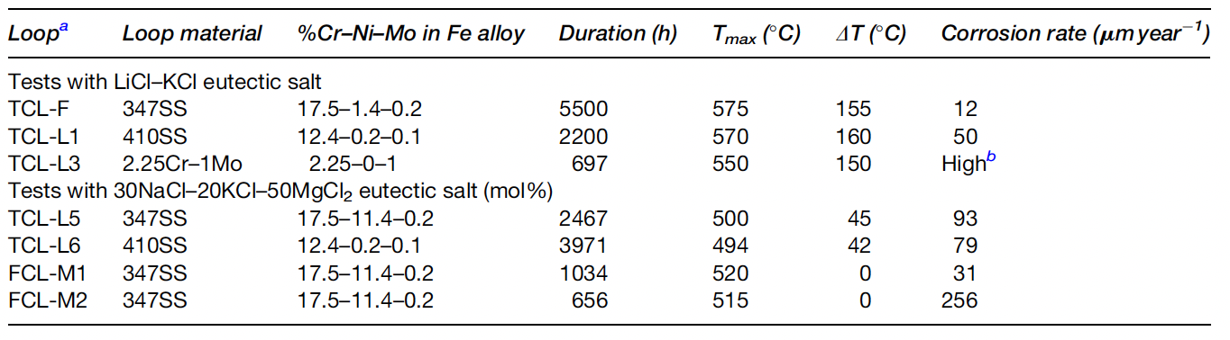
Chloride Salt Corrosion
Very little corrosion data is present for chloride salt systems
Some of the existing data does not conform to expected trends
The effect of chromium content in the alloy may not be as important of a factor, and the effect of temperature is not clear
These corrosion rates are comparable to fluoride salts with stainless steel, and are considerably higher than corrosion rates with Hastelloy-N
Active research is on-going and these statements may be out of date…

Slide 27
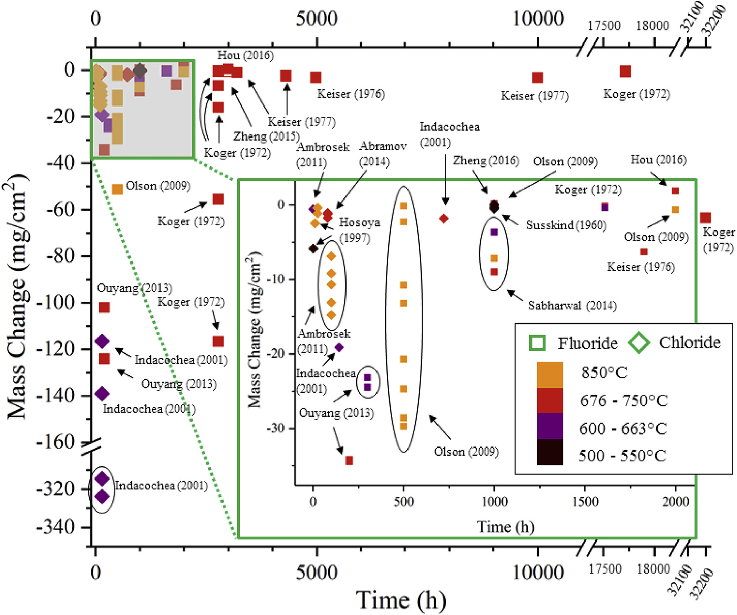
Recent Corrosion Summary
Molten salt corrosion data from studies published in 1960-2016 were aggregated and graphed
Studies were graphed by salt purity, temperature, sample material, container material, and experimental method (loop, capsule, crucible)
Data can be very scattered, and generally limited data, with more corrosion data on fluorides than chlorides
https://doi.org/10.1016/j.jnucmat.2018.07.036

Slide 28
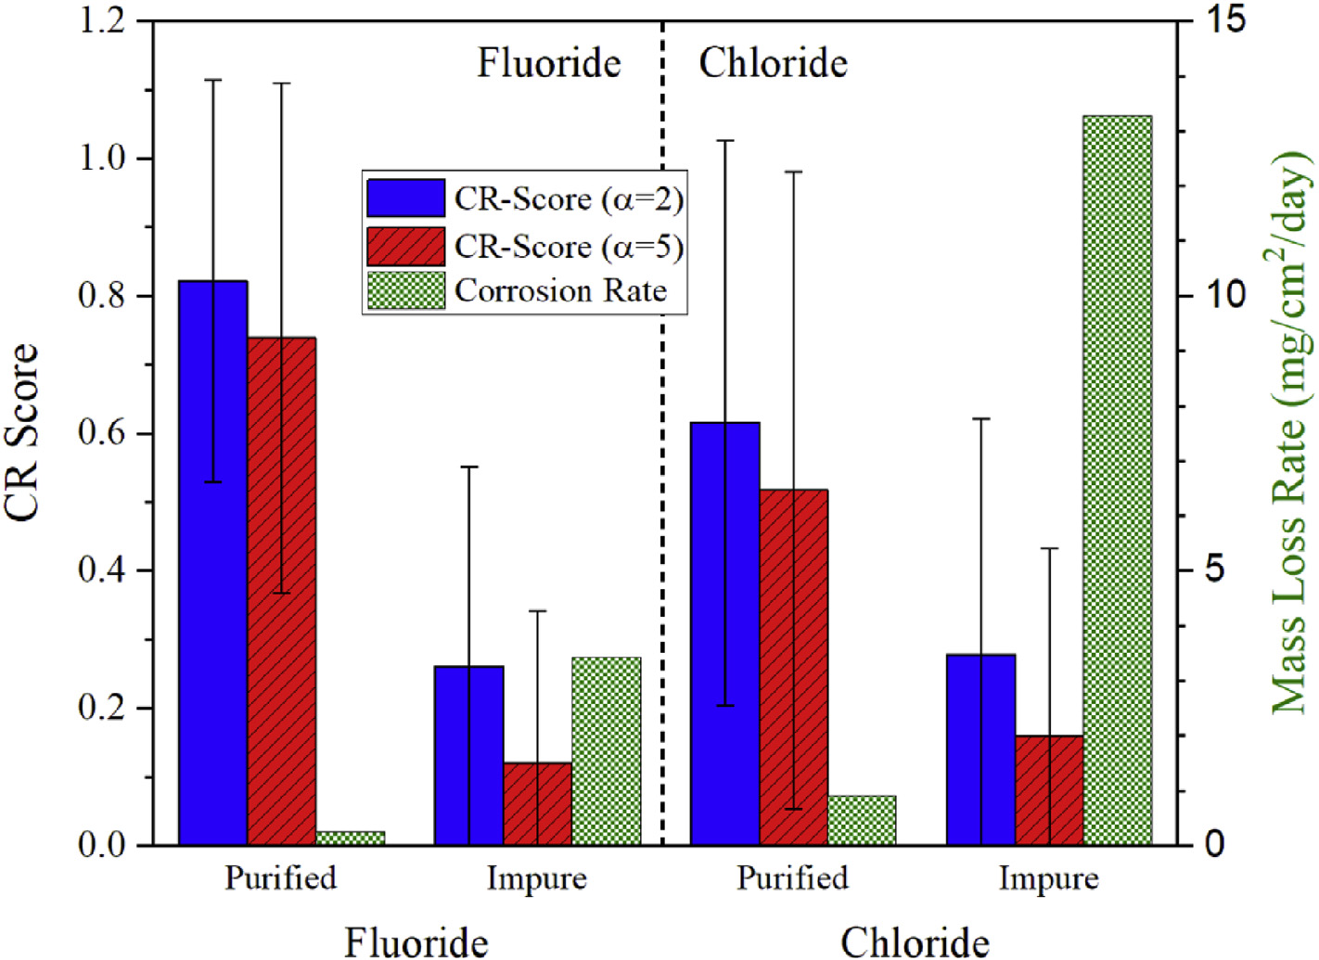
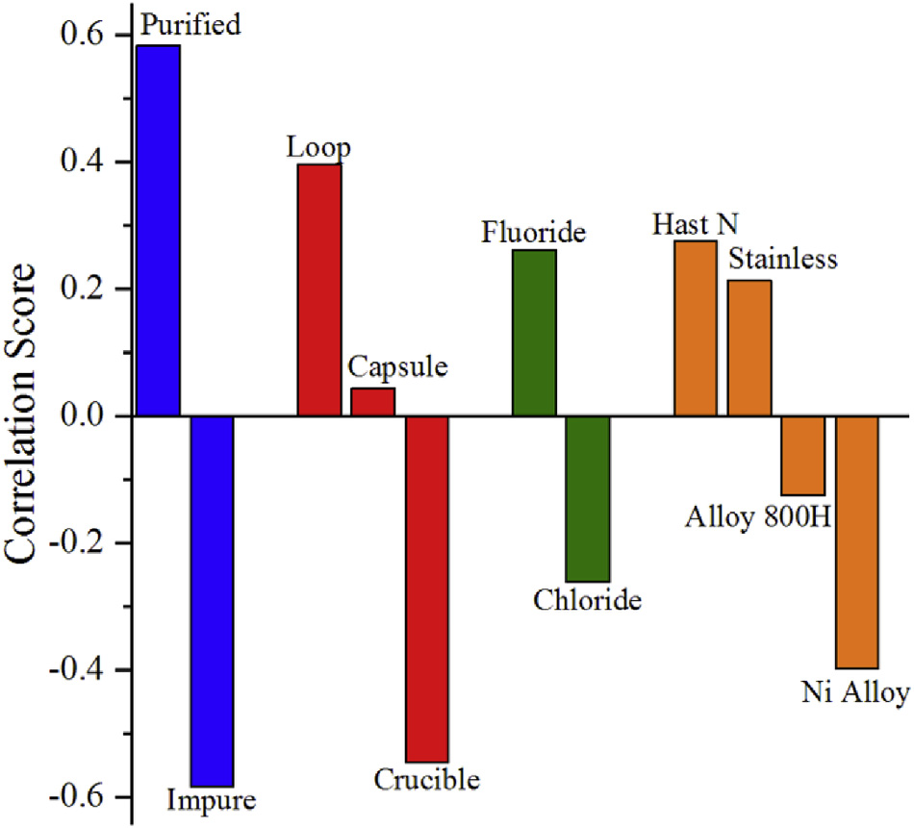
Recent Corrosion Summary
Salt purity was the factor which most affected corrosion rates
Experiment type and salt type (fluoride vs. chloride) following as the next most important factors
Higher CR score = less corrosion; Positive correlation = less corrosion

